Slide 1
Credit Risk Analysis in Banking
A Data Driven Approach
By Ahmed Khan 10/10/2024

Slide 2
Objective:
This project aims to enhance risk assessment strategies in lending institutions by leveraging data analytics to minimize the risk of loan defaults.
The insights gained from this analysis will enable lenders to make more informed decisions.
The dataset contains 150,000 rows of loan records, including 20 Fields.

Slide 3
Data Introduction:
'ID','Year' ,'Gender'-: Represents ID of customer (148670 unique IDs), gender we have Male,Female, joint,& gender missing.
‘'Loan_limit': We have two type Fixed/Confirmed and Not Fixed/Not Confirmed
'loan_type', 'loan_purpose',: 3 type of loan and 4 type of loan purpose
'business_or_commercial', 'loan_amount', 'rate_of_interest','property_value','income', 'Credit_Score', 'age','Region'
'Upfront_charges': Down payments done by applicant
'Credit_type', Co-applicant_credit_type': 4 type ( 'EXP' 'EQUI' 'CRIF' 'CIB')
'LTV', 'Status': 0 Represents Non-Default loans and 1 Represents Defaulted loans

Slide 4
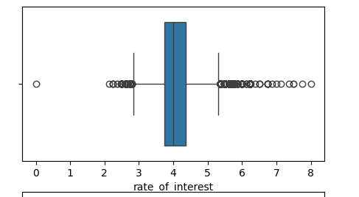
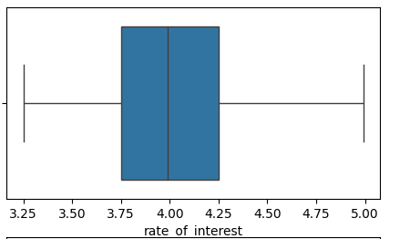
Data Preparation:
Missing Values : We have highest missing values in two columns about 25% values were missing in both Rate of interest and upfront charges column. Other fields contains less than 10% missing values.
Imputed missing values for categorical columns using multiple relevant group by, by taking there mod.
For numerical column took median values of multiple groups.
Outliers: Identified outliers using boxplot then replace them to NAN, Again imputed NAN using mean values obtained from multiple groups. A Box-Plot is shown below, like that i did for all
Before Removing Outliers
After outliers treatment

Slide 5
Feature Engineering:
Binned some of the important Numerical column into Bins and make it categorical.
Derived new variable “Risk Category” by Loan-to-Value (LTV) ratio, credit score category, and income category. By applying specific conditions to these variables, we assigned risk categories ranging from "Very Low Risk" to "Extremely High Risk." This new feature provides a more nuanced understanding of the risk associated with each loan, thereby improving our risk assessment capabilities.
Derived calculated column like Debt to income ratio and some other by performing arithmetic operations.

Slide 6
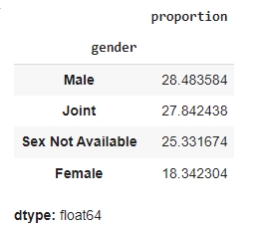
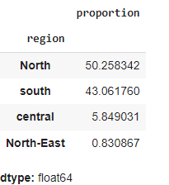
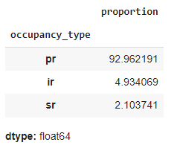
Exploratory Data Analysis (EDA):
EDA of Categorical columns:
93% of loan limit are fixed or confirmed, Among male, female, and joint, 28% borrower are male,Mostly Applicant age between 45-54
Type1 loan type is most popular among borrower, 92% of Occupancy type is pr (Public/residential)
The P3 loan purpose is the most frequent, indicating a general preference against business loans.
50% of loan applicant belongs to North region,Most of loans are small amount, and Medium LTV are most frequent.
52% borrowers belongs to Lower-Middle class, and 42% Property value belongs to standard category.

Slide 7
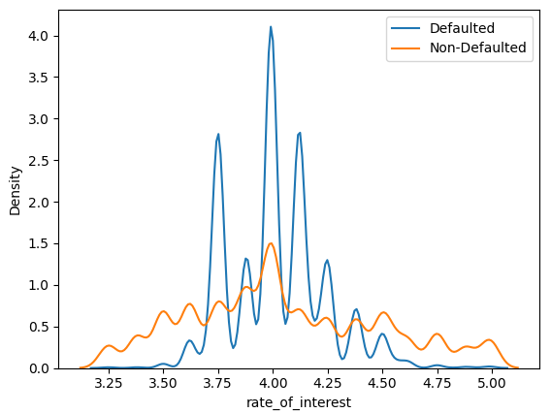
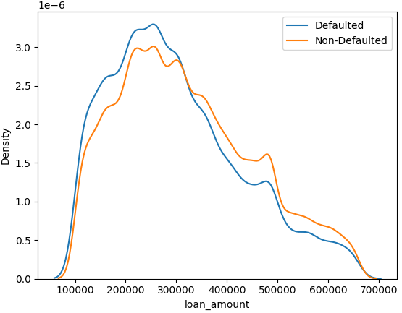
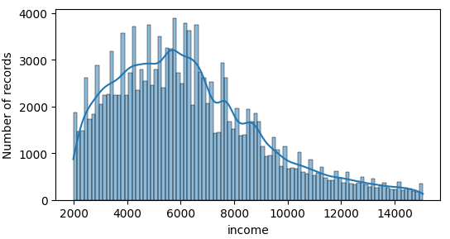
EDA of Numerical Fields: The average loan amount is approximately 315k, and the majority of loan amounts vary between 106k and 406k.
The mean interest rate is about 4%, The mean upfront charges are around 2629, but the high standard deviation (1998) shows considerable variability. 75% of the data lies below 3862.
The average property value is approximately 443k, with a minimum of 148k and a maximum of 1008k.
The mean income is 6318, and the standard deviation of 2790 suggests that most incomes fall between 3528 and 9108 (mean ± std).
The average Loan-to-Value (LTV) ratio is 75.8%.
About 24.6% of the loans have defaulted (as indicated by the "Status" column where 1 represents a default and 0 represents no default).

Slide 8
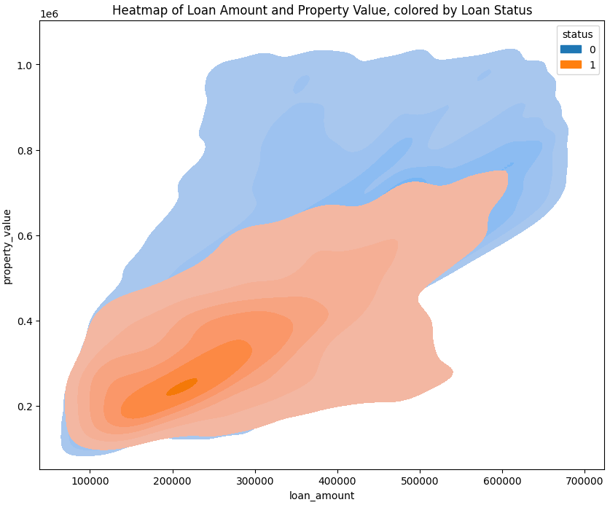
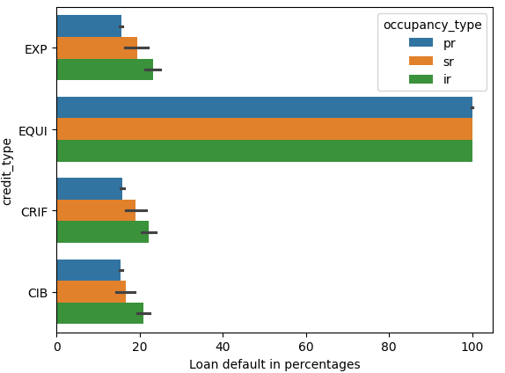
Visual Representations:
Key Finding:
There is high concentration of Loans in Lower left quadrant & +ve
correlation
EQUI credit type Almost 100% default rate

Slide 9
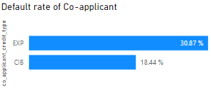
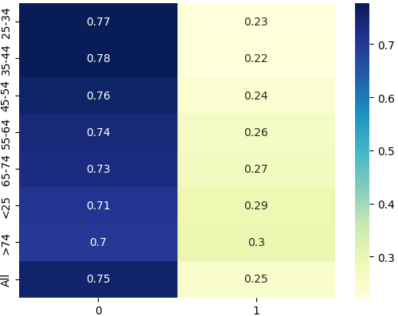
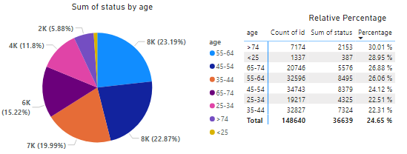
3. Default Rate of co-applicant when considering EXP credit type has high,so for co-applicant credit type should choose CIB as credit type or else Implement strict loan approval rules for co-applicants with credit scores from EXP.
4. As age increases default rate increasing except less than 25

Slide 10
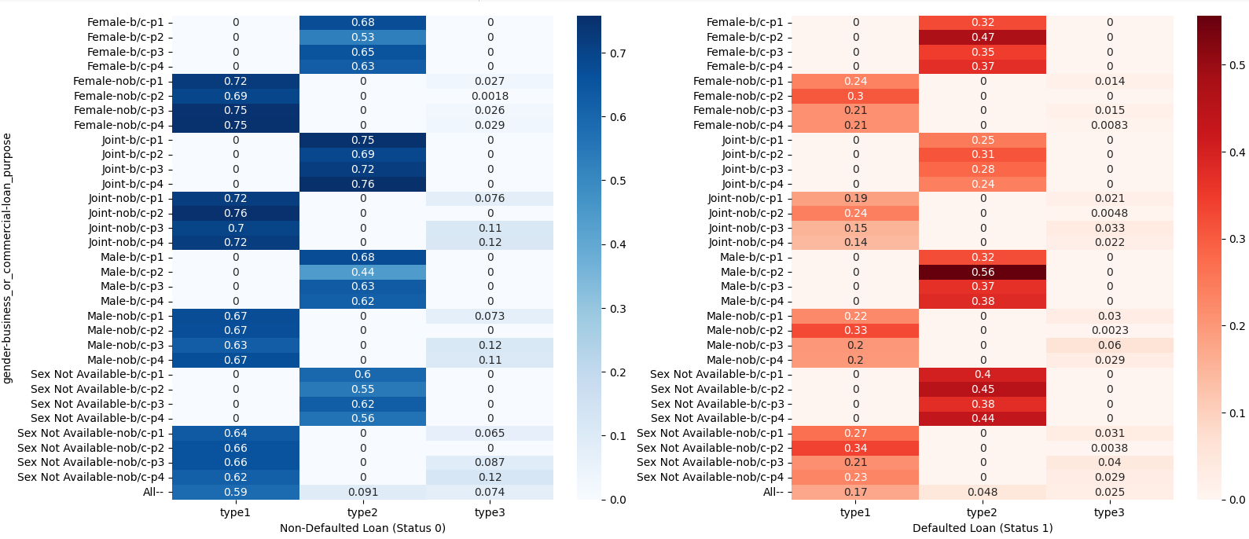
5. Blue hues represent safer loans, while red hues indicate riskier ones.

Slide 11
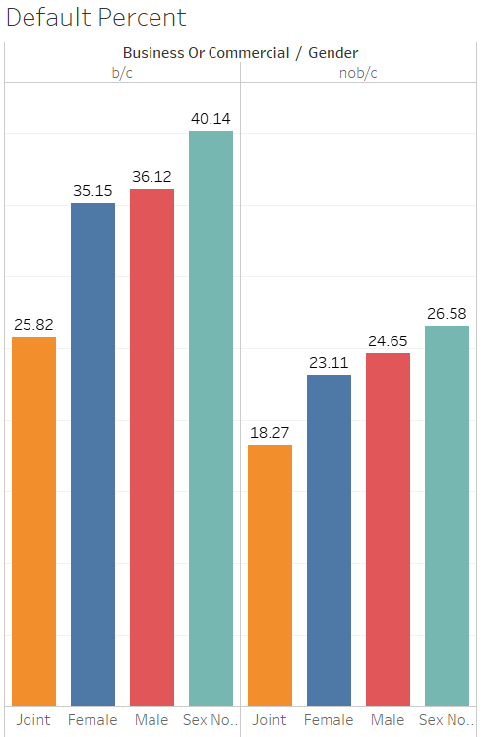
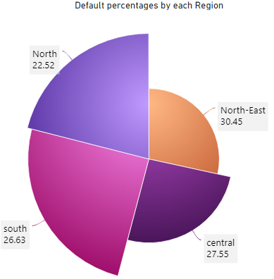
6. Height of bar denotes total default in % & color denotes gender
7. Radius shows the population of loan applicant by each region and angle shows percentages of Loan defaults.
Business or Non-Business/Gender

Slide 12
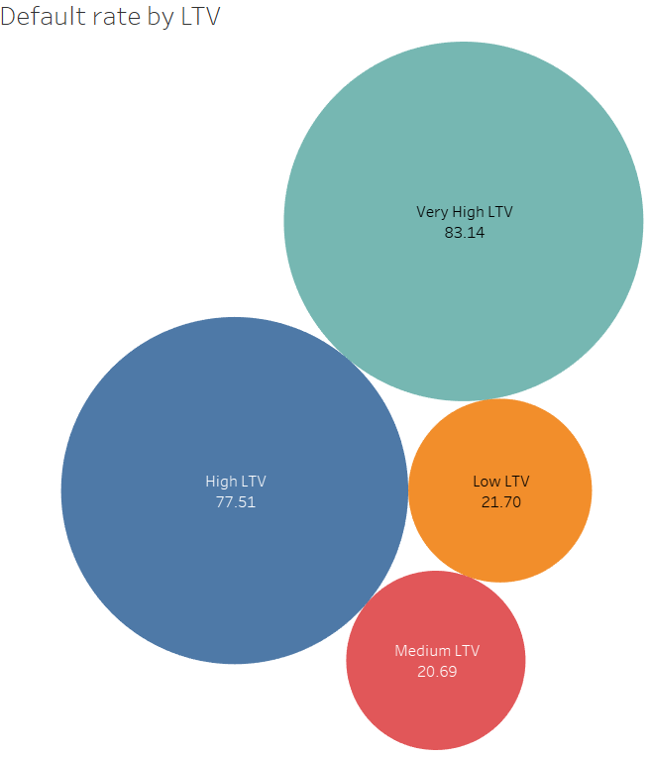
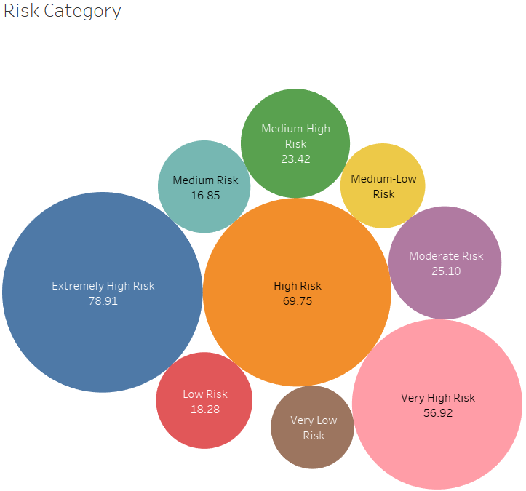
8. Bigger the size represent huge percent of loan default, Risk Category is derived feature with the help of Feature Engineering.

Slide 13
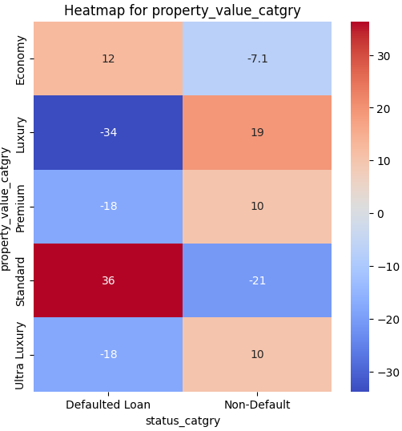
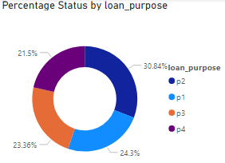
Standardized Residuals Heatmap for Property Value Categories: Negative values indicate weak or no association, while higher positive values represent stronger associations

Slide 14
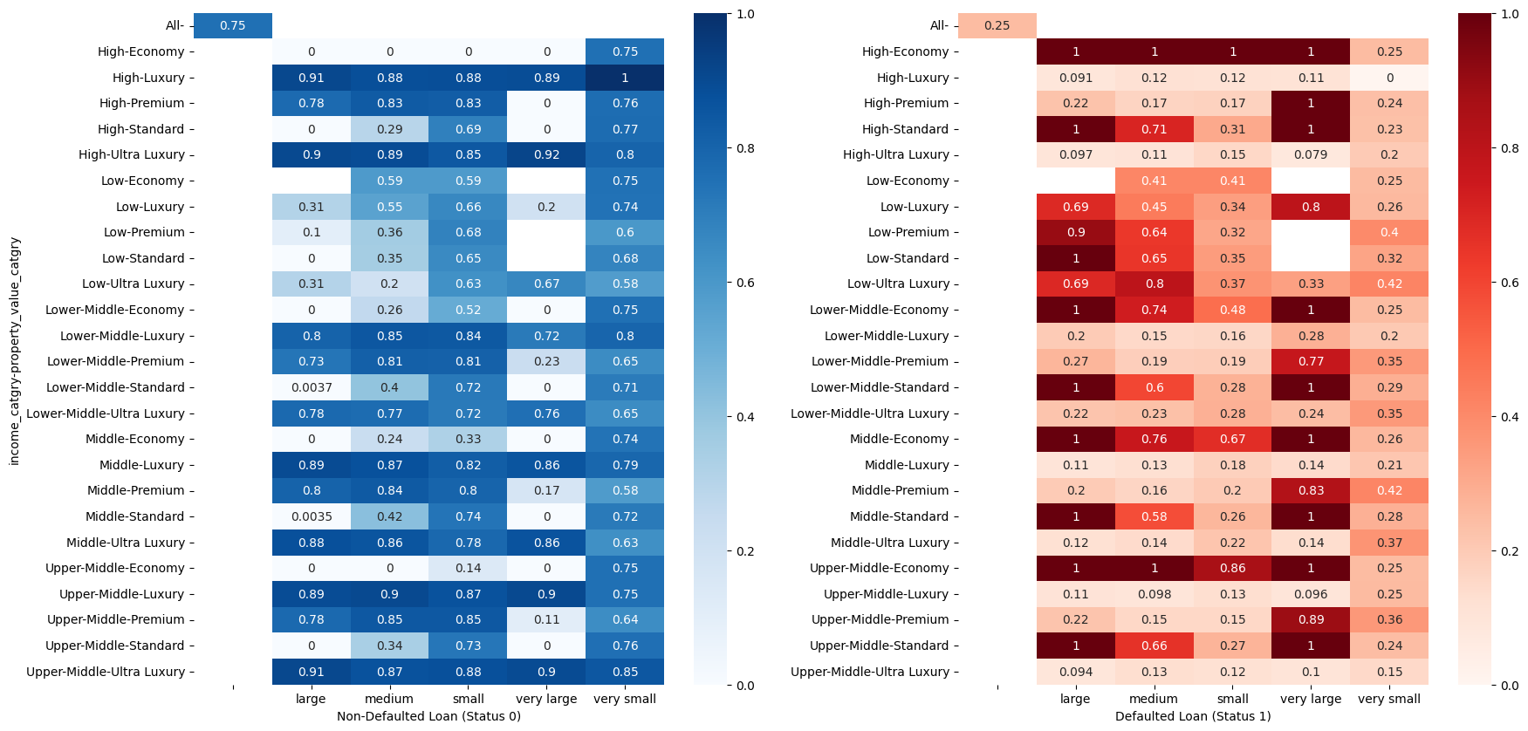
8. Blue hues represent safer loans, while red hues indicate riskier ones. (Loan_amount, Property Value, income)

Slide 15
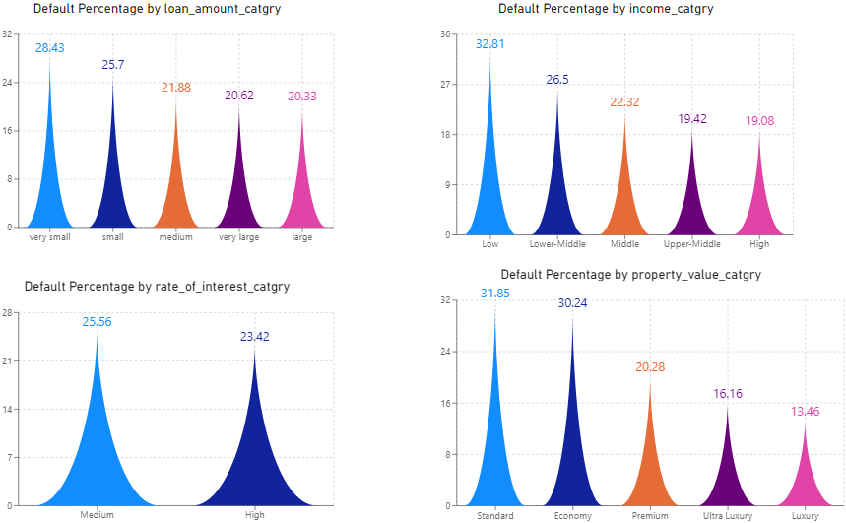
Effect size:
To quantify the impact of numerical columns on default rates, Cohen's d was computed.
Cohen’s d = 0.158
Cohen’s d = 0.204
Cohen’s d = 0.093
Cohen’s d = 0.392

Slide 16
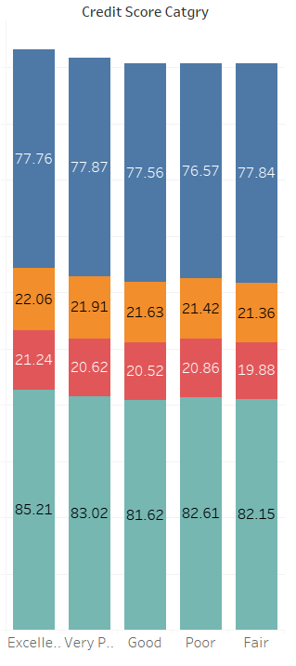
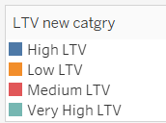
Credit Score:
Cohen’s d value of credit score is 0.0093, shows very small impact
P_vale after T test = 0.12090841773434603,
There is no significant effect of credit_score on default status
LTV:
Cohen’s d value of LTV is 0.407, shows very significantly good impact
Found P_value less than 0.05, suggest there is impact on default loan.
Impact of credit score and LTV on default loan

Slide 17
Conclusion:
Most of the borrowers belong to the lower to middle-income class and are primarily from the North and South regions. Their first preference for loans is Type 1, and the preferred occupancy type is PR. The majority of the loans are for small amounts, with the purpose being P3. The property values typically range between $200,000 to $400,000, with the standard category being the most preferred
Equi credit type has almost 100% default rate, and among all credit type sub_cat occupancy type IR on top and SR has 2nd most defaulted loan, while checking co applicant credit type CIB is good, EXP has high default rate
As the Age increases default rate increases, In gender where the gender is missing has high default rate, Business loans are more likely to default
High and very high LTV 78 to 84% chances to default, purpose p1 has 31% default rate where as property category standard and economy more likely to default.
Surprisingly credit score has no impact on default rate

Slide 18
Recommendations:
Focus on LTV Ratio: Lenders should prioritize evaluating loan applications based on the LTV ratio, as it has a significant impact on loan defaults. Should increase downpayment and introduce insurance to such loans
Stricter Credit Assessments for Certain Credit Types: Implement stricter lending policies for loans using EQUI and EXP credit types, it is better to discontinue EQUI. Encourage the use of CIB credit type for co-applicants.
Reevaluate Loan Policies for Older Borrowers: Since older borrowers tend to default more, consider adding age-based risk adjustment factors to the loan approval process.Ensure that gender data is collected accurately,because where gender missing those loans are likely to default.
Improve Risk Categorization: Use the derived risk categories (Very Low Risk to Extremely High Risk) to tailor loan offerings and risk mitigation strategies for high-risk borrowers.Introduce more stringent evaluation criteria for business loans
Implement stricter credit assessments for Loan Type 1 applicants, especially for small loans. For Occupancy Type IR, apply stricter approval criteria, such as higher income requirements or larger down payments. This should be coupled with continuous monitoring to mitigate risk.
Introduce specialized products for Purpose P1 loans with stricter approval processes, perhaps offering lower loan limits or shorter repayment terms to minimize risk.Assess the property value and adjust the lending terms accordingly for these categories, perhaps requiring lower LTV ratios, better credit scores, or additional collateral.

